Slide 1
Online Doctor visit appointment
Shubham Gantayat
Suraj Kumar

Slide 2
Objective –
To create a web application to facilitate the functionality for the patient to book an appointment with a doctor online.
Benefits –
Allow patients to book an appointment with the doctor based on their needs.
Allow patient to Cancel appointment before 3 days.
Allow the patient to book an appointment within 15 days.
Allow the doctor to cancel all or reschedule appointment of a patient if somethings come up and notify same to all patient.
If any patient tried and due to limitations of appointment they were not able to book an appointment suppose somehow if the booked appointment has been cancelled then all patient whosoever tried should receive notification regarding availability of appointment so that they can book again.

Slide 3

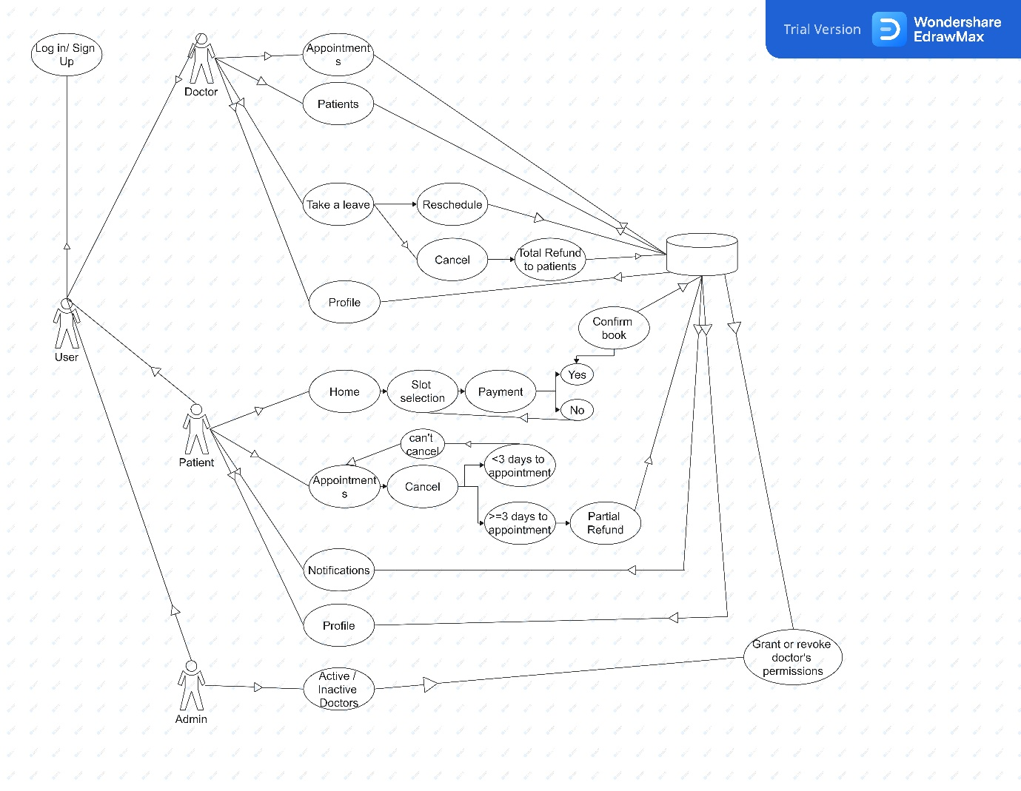
Architecture

Slide 4
Login
First thing anyone will see is the login window, which will ask the user for username and password to login. Sign Up toggler will redirect to signup window.
2. Signup
The signup window opens when you click the signup button at the login page. Sign up page is different for both doctor and patients.
3. Doctor – Appointments
This page will show the appointments for upcoming 15 days along with patient details.

Slide 5
4. Doctor – Patients
This section allows the doctor to see the past patient details whom they have diagnosed.
5. Doctor – Take a leave
Doctor can take a leave for a specific period. During that time all the appointments will be rescheduled to the nearest possible opening and the patients will be notified.
6. Doctor – Profile
Doctor can visit their profile for setting up payment details and edit their initial information.

Slide 6
7. Patient – Home
This section allows patients to search for a doctor by name or speciality and allows them to book an appointment.
This window shows a list of doctors. On clicking doctor image the booking window opens
8. Patient – Appointments
This allows patients to see their past as well as upcoming appointments.
9. Patient – Notification
This section displays reminder, rescheduling and cancellation of appointments.

Slide 7
10. Patient – Profile
Patients can visit their profile for setting up payment details and edit their initial information.
11. Admin – Active
Admin can view all the active doctors and can cancel their active license on the site in case of a dispute.
12. Admin – Inactive
Admin can activate the account of a doctor after verifying the account details and doing a background check.

